Slide 1
LOW LIGHT IMAGE ENHANCEMENT
DOMAIN : ARTIFICIAL INTELLIGENCE
TEAM MEMBERS :
C.AJAY – 19BD1A0569
D.ROHIT- 19BD1A056D
P.DHARAN TEJ – 19BD1A057F
S.SUDHEENDRA – 19BD1A057N

Slide 2
POINTS TO BE DISCUSSED
ABSTRACT
INTRODUCTION
SYSTEM REQUIREMENTS
LITERATURE SURVEY

Slide 3
ABSTRACT
ABOUT THE RESEARCH

Slide 4
ABSTRACT
When an image is capture in a poor light environment due to the low photon count and low SNR will cause image quality to reduce apparently.
To obtain a clear image contrast, sharpness and colour co-ordination should be handled simultaneously and effectively which can be a difficult task for humans when done manually.
Though denoising, deblurring, and other enhancement techniques have been proposed, their efficiency is limited in extreme conditions, such as video-rate imaging at night.
But the proposed low light image enhancement using convolutional neural network system takes dark images as input and produces bright images as an output without disturbing the content of the image.

Slide 5
introduction
REASONS FOR PERFORMING THIS RESEARCH
PROPOSED SYSTEM AND WHY?
SCOPE OF THE SYSTEM

Slide 6
introduction
Reason for performing this research
The conditions that most often lead to the degradation of such image quality include bad weather, low illumination, and moving objects, among many others. The influence of such conditions on the image quality can make it difficult for the human eye to clearly identify the contents of the image.
Enhancement techniques are often used to make the hidden content of images visible, and they aim to facilitate the usability of valuable information for human and computers alike.
Thus, image enhancement is one of the fundamental research topics in image processing.
To remove darkness and extract meaningful contents are very important tasks in applications such as medical imaging, object tracking, face detection, facial attractiveness, and object detection.

Slide 7
INTRODUCTION
PROPOSED SYSTEM
The proposed system is based on Convolutional Neural Network method to enhance low light images and improve brightness of images for many applications like scene understanding, object detection etc.
The system is designed to produce an automated, fast and accurate results which provide bright images as an output by taking dark images as an input. Also the content of an output images must be undisturbed.

Slide 8
INTRODUCTION
WHY CNN?
Various enhancement methods were proposed and they can be classified into three categories:
methods based on retinex theory – These methods process images in RGB channels separately, they may cause color distortion when the original image does not follow with the gray world assumption.
histogram equalization (HE) algorithms – Produces undesirable artifacts, details in dark areas are not enhanced appropriately and they still cause color distortion in many cases.
methods using dehaze model - the saturation of the processed images is usually exaggerated and sometimes over-enhanced, which make results look unreal.
Research shows that a CNN based model is designed to denoise low-light images thus improving the image quality before the model based enhancements.

Slide 9
INTRODUCTION
SCOPE OF THE SYSTEM
An attempt has been made to enhance the low lighted image using CNN.
Several approaches have been proposed by the researchers like LLCNN, MSR-net, MIRNet etc. and each approach has been proved to be practical and essential along with its shortcomings.
There is still scope to enhance this system, by creating new approaches by either combing two or more existing ones or by inventing an new approach altogether.
The system can be carried further to enhance the quality of the video which is shot in low light and also to enhance the quality of the image/video.

Slide 10
SYSTEM REQUIREMENTS
HARDWARE REQUIREMENTS
SOFTWARE REQUIREMENTS

Slide 11
SYSTEM REQUIREMENTS
HARDWARE REQUIREMENTS
OS: Windows 7 OS or above Recommended: Windows 11 (latest)
CPU: Intel core i5 or above, AMD Ryzen 5 or Above
Disk Storage: 8GB or above of free disk space
RAM: 4GB or above
GPU: Intel Integrated Graphics or higher
For Execution: Spyder using Anaconda Framework in Python or Google Collab

Slide 12
SOFTWARE REQUIREMENTS
SOFTWARE REQUIREMENTS
Python : Easy to implement and built in modules.
pandas : data cleaning and analysis.
NumPy : Numerical and scientific computing.
Keras : Python interface for evaluating neural networks.
TensorFlow : An end-to-end open-source platform with flexible tools, libraries that helps develop and to easily build and deploy ML powered applications.
Matplotlib : data visualization and graphical plotting
OpenCV : huge open-source library for the computer vision, machine learning, and image processing

Slide 13
Literature survey

Slide 14
Literature survey
Low-light image enhancement using CNN and bright channel prior
Authors: Li Tao; Chuang Zhu; Jiawen Song; Tao Lu; Huizhu Jia; Xiaodong Xie
The researchers designed a convolutional neural network to remove image noise which achieves a good performance.
A low-light model was proposed and bright channel prior was used to calculate transmission in low-light model.
Experimental results showed that our algorithm can better improve brightness, enhance contrast and preserve details compared with other methods.

Slide 15
literature survey
2) LightenNet: A Convolutional Neural Network for weakly illuminated image enhancement
Authors: Chongyi Li, Jichang Guoa, Fatih Porikli, Yanwei Pang
The researchers formulated a compact and efficient CNN, namely LightenNet, and subsequently obtain an enhanced image based on Retinex model.
The proposed LightenNet learns mapping between weakly illuminated image and the corresponding illumination map which is subsequently used to obtain the enhanced image.
The results obtained were images with natural and realistic appearance and with improved brightness and contrast.

Slide 16
LITERATURE SURVEY
3) LLCNN: A Convolutional Neural Network for Low-light Image Enhancement
Authors: Li Tao, Chuang Zhu, Guoqing Xiang, Yuan Li, Huizhu Jia, Xiaodong Xie
The researchers proposed a network called as Low-light Convolutional Neural Network (LLCNN).
It learns to filter low-light images with different kernels and then combine multiscale feature maps together to generate enhanced images.
SSIM loss is integrated into the proposed LLCNN to reconstruct more accurate image textures.

Slide 17
LITERATURE SURVEY
4) A Convolutional Neural Network Based Method for Low-illumination Image Enhancement
Authors: Huang Huang, Haijun Tao, Haifeng Wang
The researchers proposed a model called as Unet whose processing is similar to the well known image pyramid method.
It is a special U-shaped CNN model proposed for biomedical image segmentation
Unet produces low scales images by pooling and reconstructs the images scales by deconvolution.
Thus, the researchers found that the Unet is more suitable than other classical CNN model for image processing tasks in deep learning.

Slide 18
SYSTEM DESIGN
System design is the process of defining elements of a system like modules, architecture, components and their interfaces and data for a system based on the specified requirements.
It is the process of defining, developing and designing systems which satisfies the specific needs and requirements of a business or organization.

Slide 19
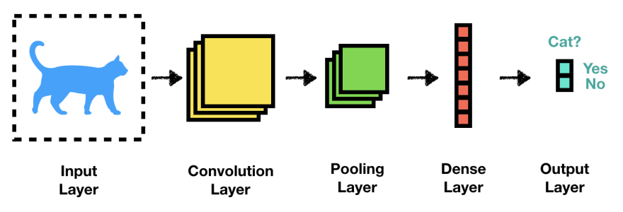
Architecture of CNN

Slide 20
ARCHITECTURE OF CNN
Convolutional Layer - used to extract the various features from the input images
2) Pooling Layer - this layer is to decrease the size of the convolved feature map to reduce the computational costs.
3) Fully Connected Layer – This layer consists of the weights and biases along with the neurons and is used to connect the neurons between two different layers.
4) Dropout - a dropout layer is utilized wherein a few neurons are dropped from the neural network during training process resulting in reduced size of the model and thus preventing overfitting.
5) Activation function - decides whether a neuron should be activated or not.

Slide 21
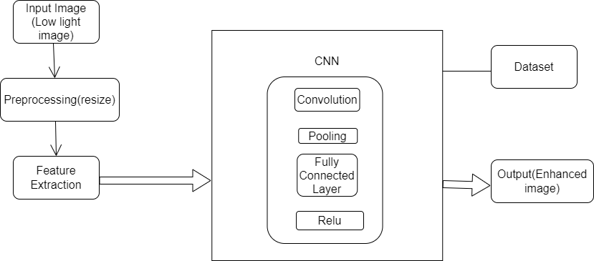
NETWORK ARCHITECTURE OF CNN

Slide 22
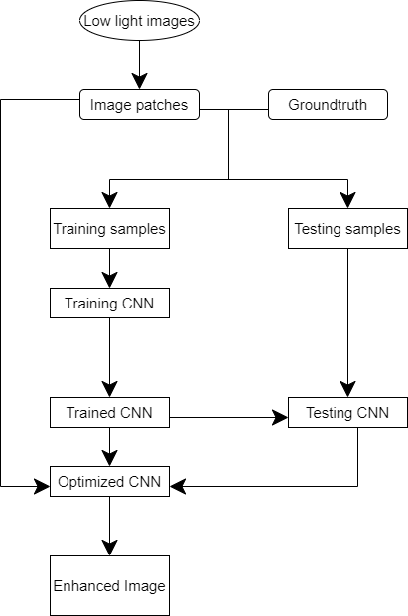
Flow chart of CNN

Slide 23
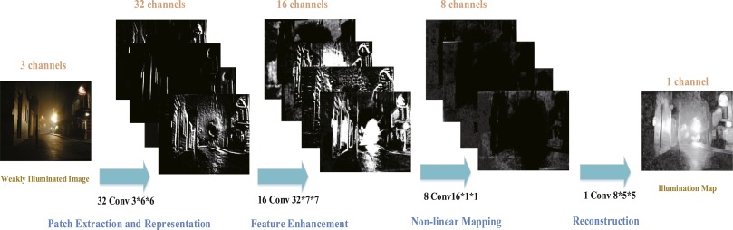
NETWORK ARCHITECTURE OF THE PROPOSED MODEL

Slide 24
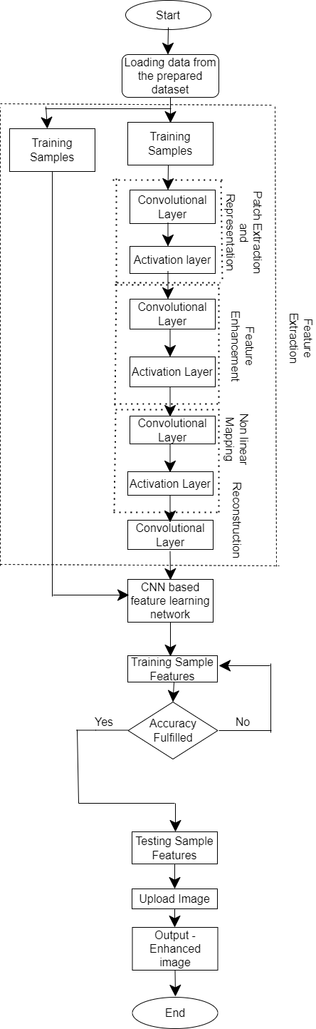
SYSTEM ARCHITECTURE OF LIGHTEN-net model

Slide 25
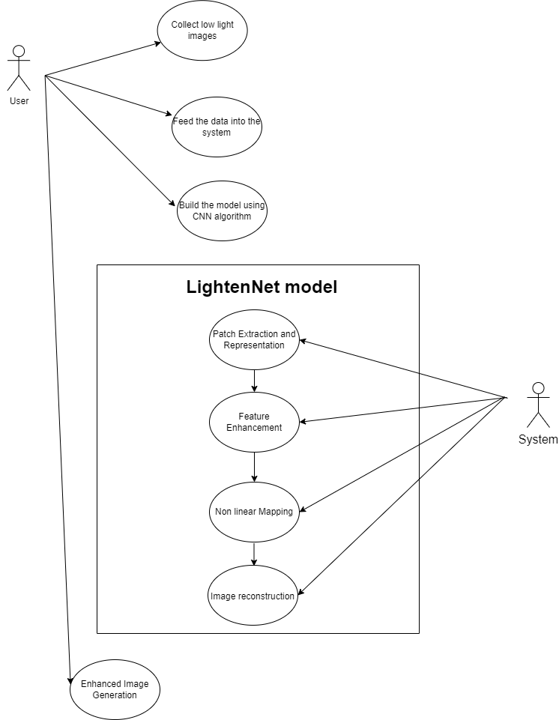
USE case diagram of lighten-net model

Slide 26
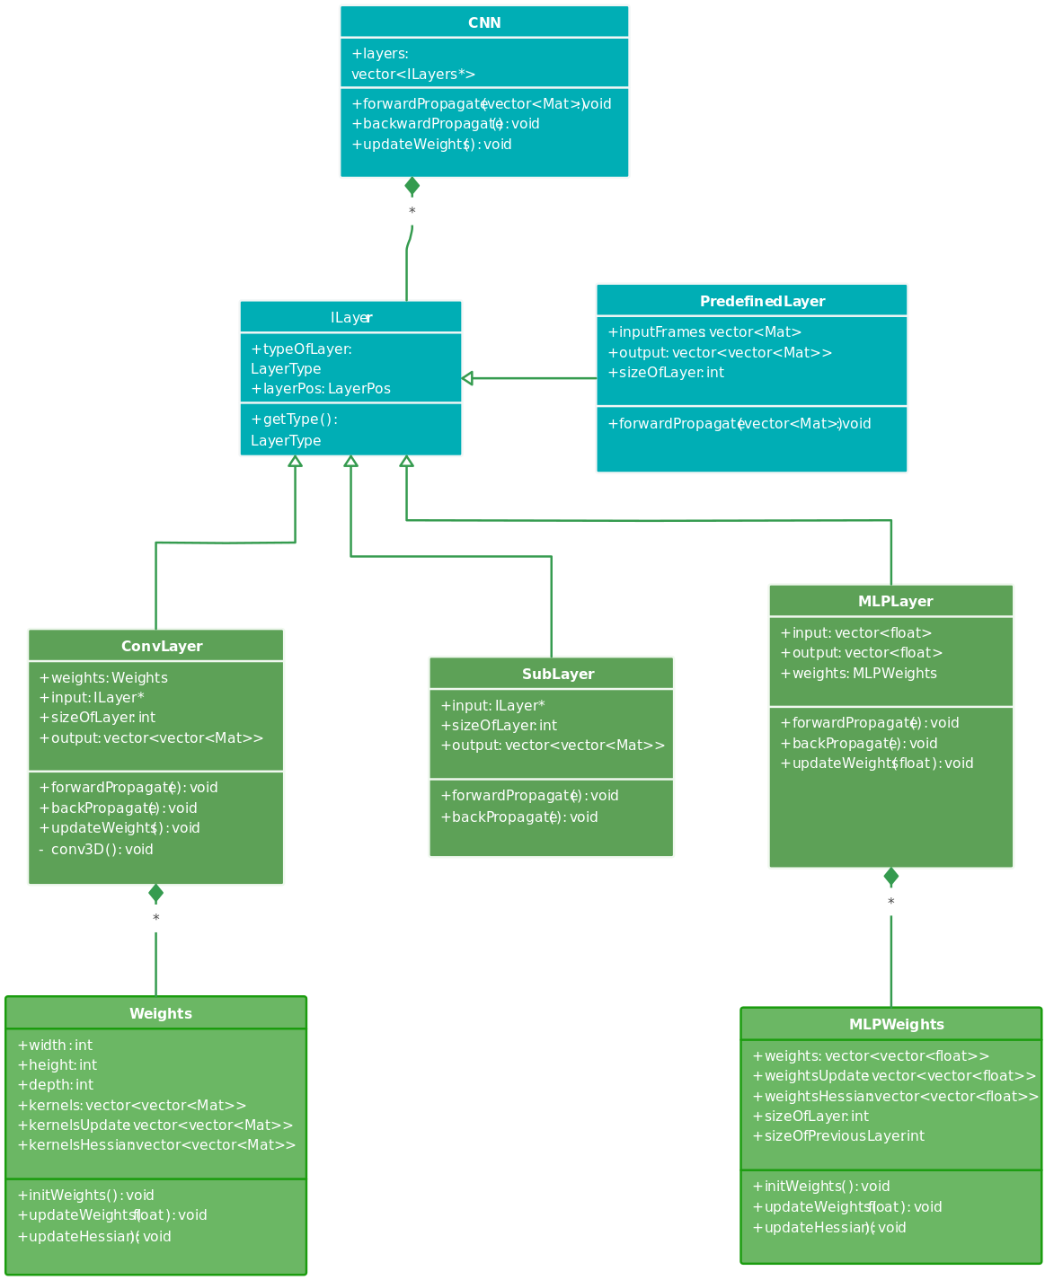
CLASS DIAGRAM

Slide 27
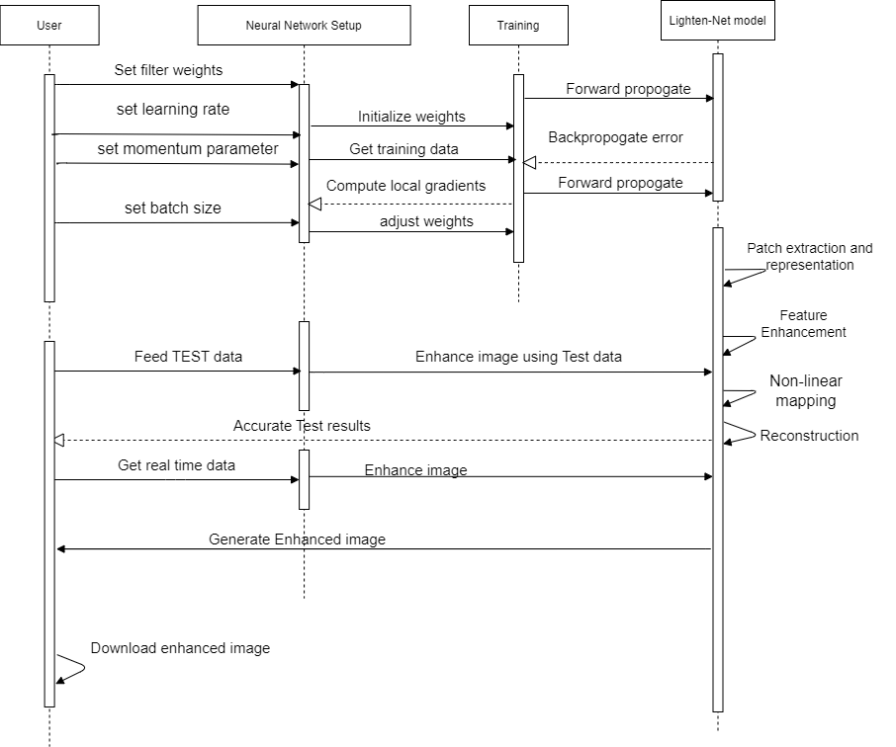
SEQUENCE DIAGRAM

Slide 28
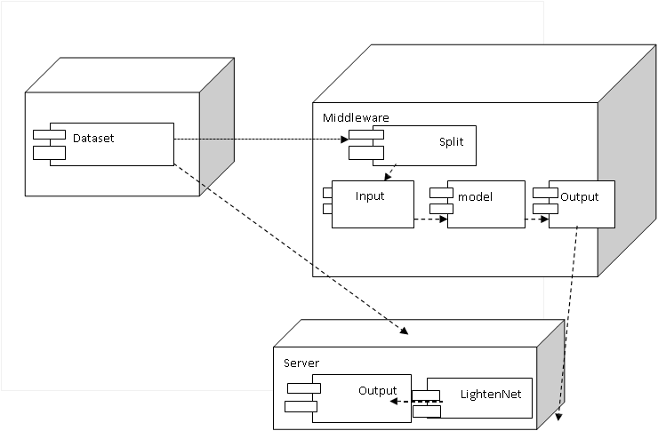
DEPLOYmENT DIAGRAM

Slide 29
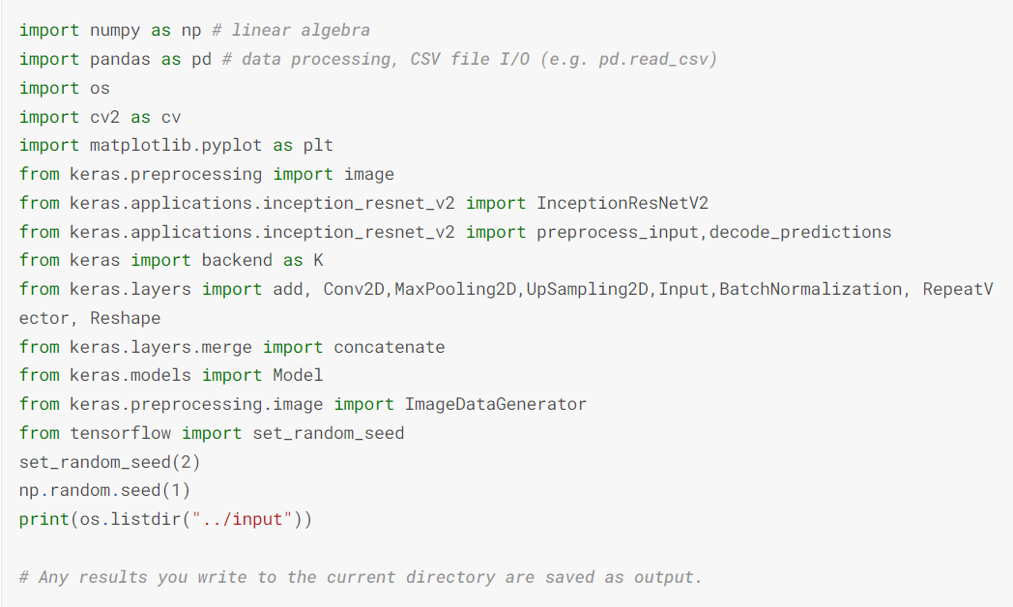
Implementation
Importing all the modules required

Slide 30
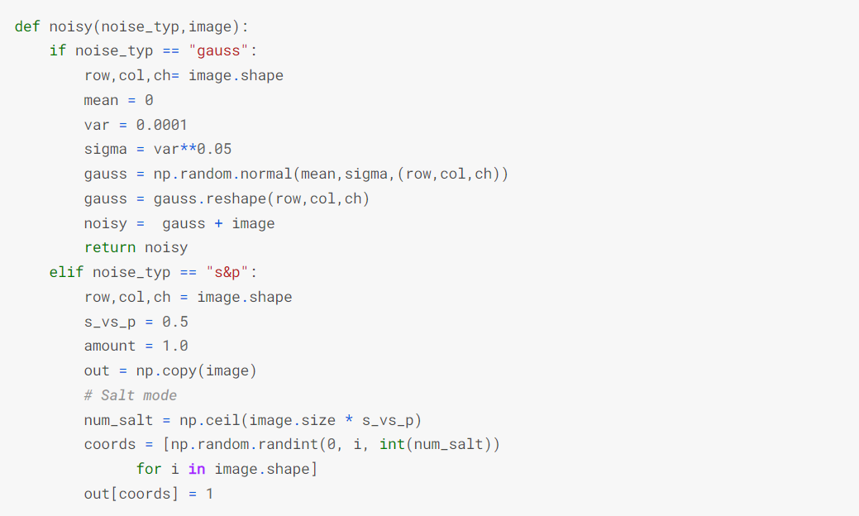
IMPLEMENTATION
Adding noises to the images
Gaussian Noise – Type of noise added to the data that follows random distribution.
Salt and petter – random pixels are set to maximum and minimum values resembling black and white dots.

Slide 31
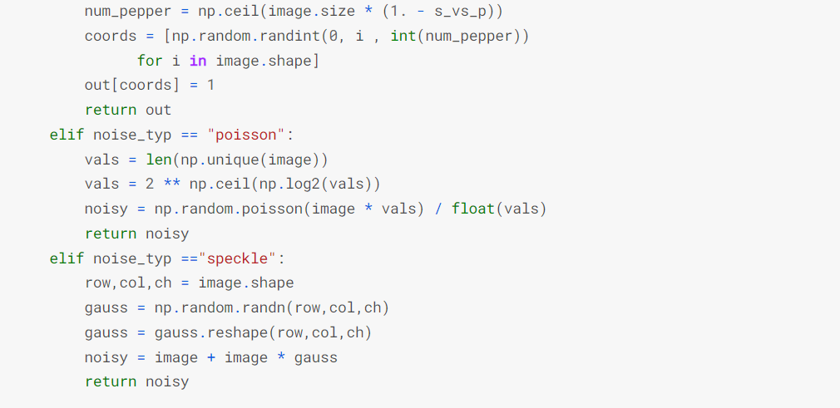
IMPLEMENTATION
Poisson noise – type of random variation which follows Poisson distribution
Speckle noise - type of noise that appears as grainy patterns in digital images, caused by constructive and destructive interference of light or other waves.

Slide 32
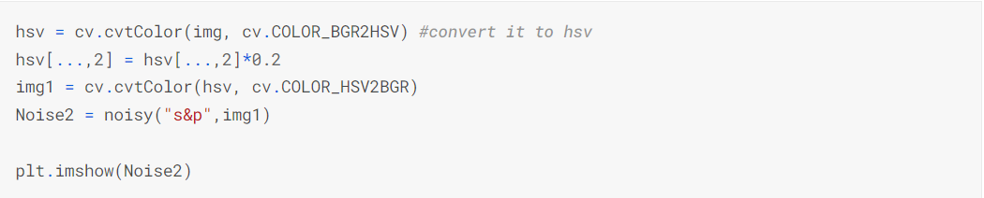
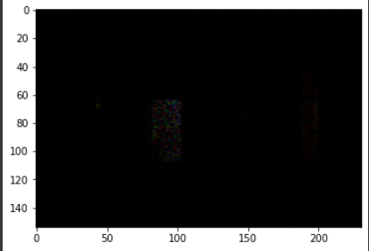
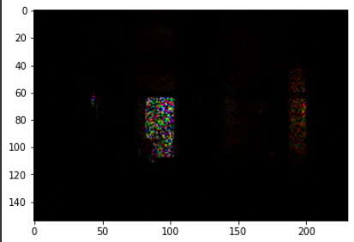
IMPLEMENTATION

Slide 33
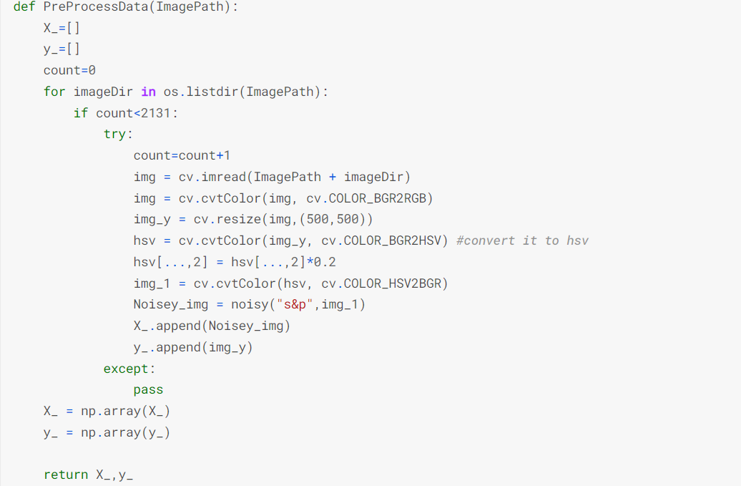
IMPLEMENTATION
Pre-processing the images by
Resizing the images
Converting the colour space
Reducing the images
Adding salt and pepper noises

Slide 34
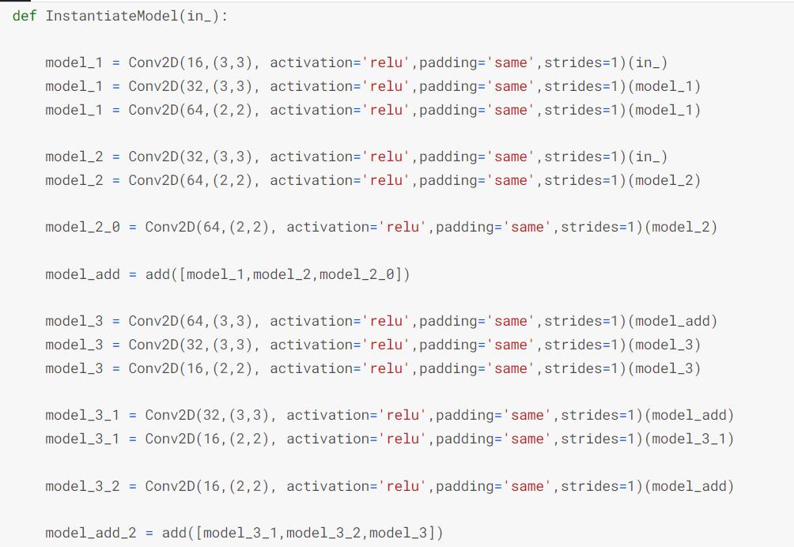
IMPLEMENTATION
Creating the CNN Model

Slide 35
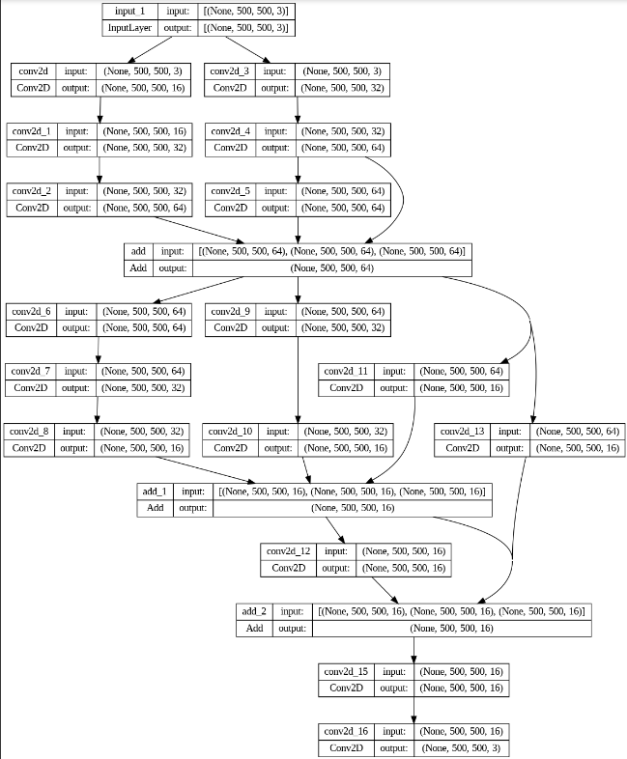
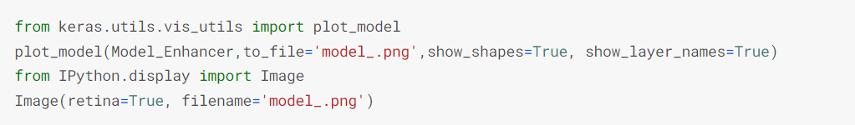
IMPLEMENTATION

Slide 36
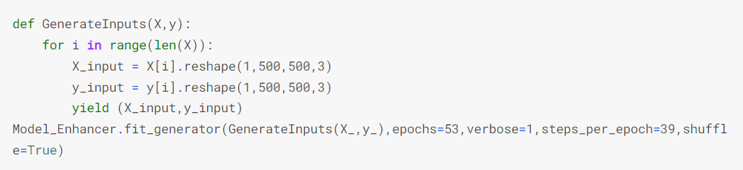
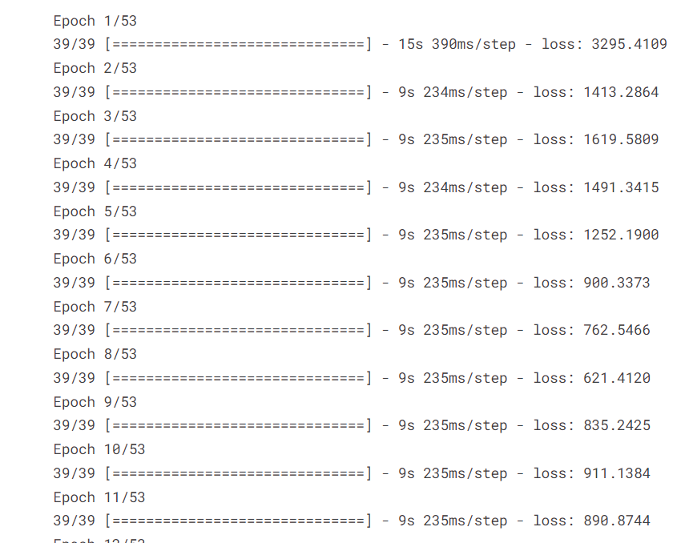
IMPLEMENTATION

Slide 37
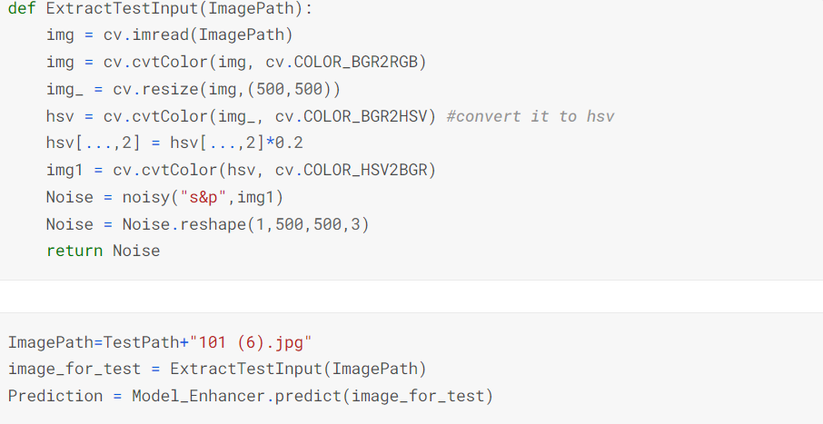
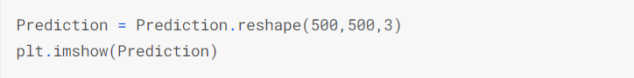
IMPLEMENTATION

Slide 38
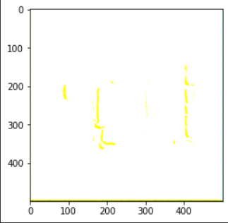
Implementation

Slide 39
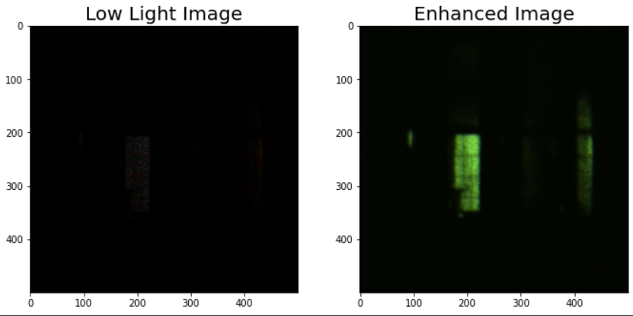
implementation
COMPARITIVE ANALYSIS OF THE LOW LIGHT IMAGE AND THE ENHANCED IMAGE BY THE MODEL

Slide 40
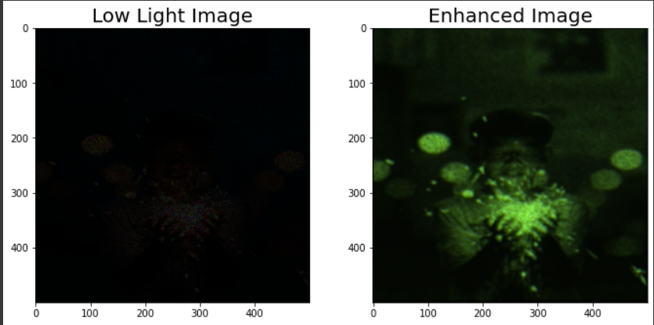
IMPLEMENTATION

Slide 41
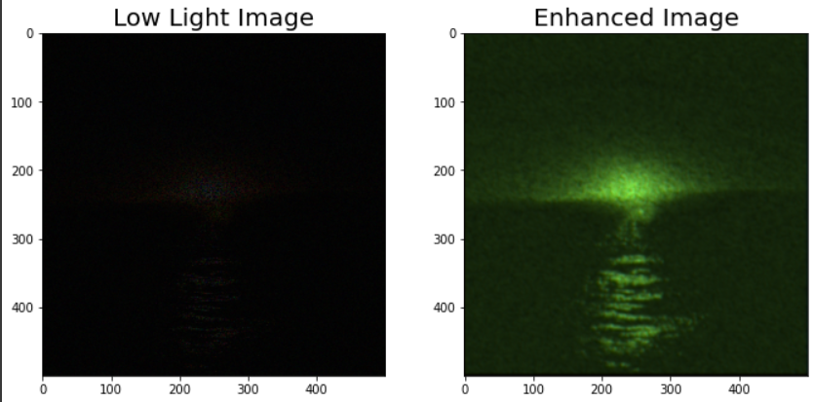
IMPLEMENTATION

